Slide 1

SEC Update – Through an Environmental Lens
SEC proposal overview and key elements
Scope 3 and materiality
Timing and execution
Best practices and integration into EHSMS and ESG strategy

Slide 2
SEC Timeline
2010
SEC issued general guidance on climate change considerations in public disclosures.
Mar. 2021
SEC created a Climate and ESG Task Force in its Division of Enforcement “with an eye toward facilitating disclosure of consistent, comparable, and reliable information on climate change.”
Sep. 2021
SEC says formal rules may slip to 2022 but circulate sample comment letter.
Mar. 2022
Proposed Rules for Climate-related disclosures.

Slide 3

SEC Proposal Overview and Key Elements
Impact of climate-related risks on company’s strategy, business model, and outlook
Oversight and governance
Risk management
GHG emissions (Scope 1 and 2)
Targets and goals
Financial statements

Slide 4
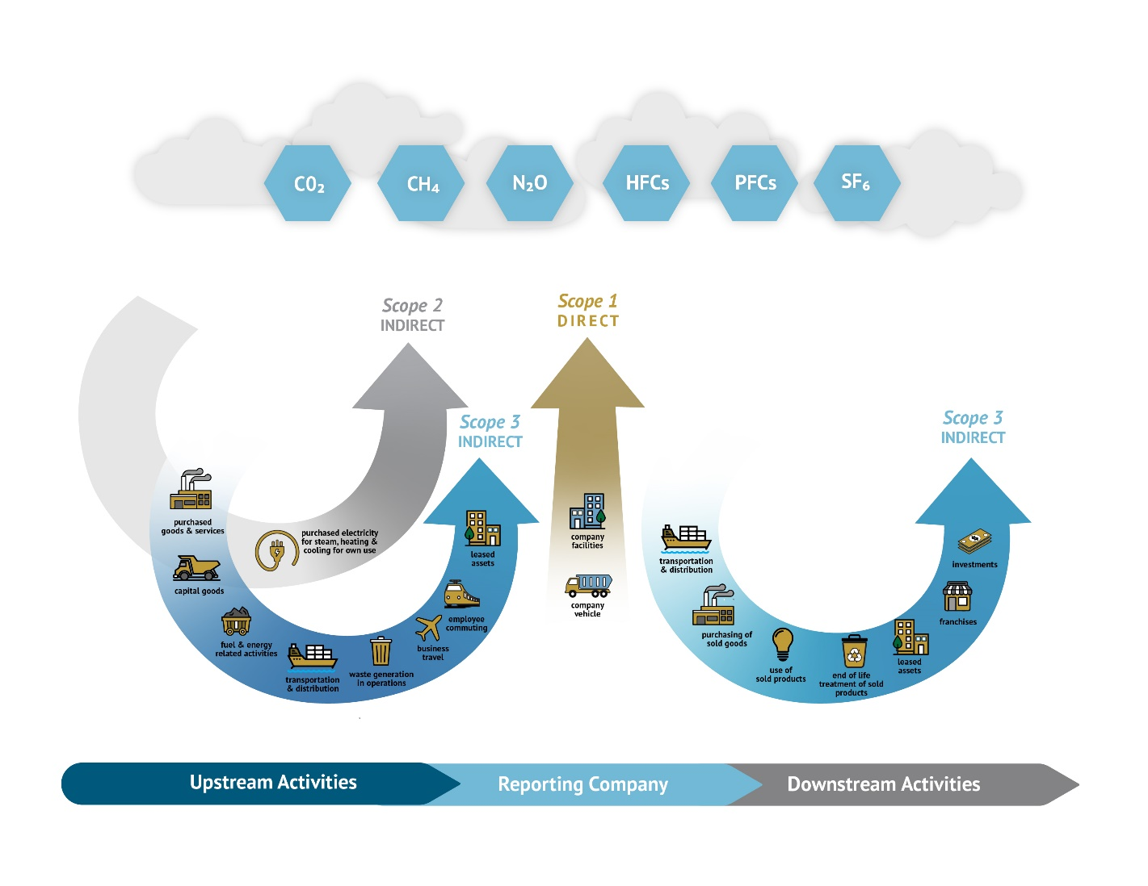
Notes:
Scope 1 emissions are direct GHG emissions from operations that are owned or controlled by a company, and Scope 2 emissions are indirect GHG emissions from the generation of purchased or acquired electricity, steam, heat, or cooling consumed by internal operations.
Disclose separately by:
disaggregated constitutent GHGs
aggregated
gross (metric tons of CO2e)
Intensity (metric tons of CO2e per unit of total revenues or per unit of product produced)

Slide 5

Scope 3
Only disclose if they are “material” or if company has set a GHG emissions reduction target
Safe harbor for Scope 3 emissions disclosure from certain forms of liability under federal securities law
An additional year to comply with the disclosure requirement beyond the compliance date for the other rules
Notes:
All indirect GHG emissions occurring in the upstream and downstream activities in a company’s value chain.

Slide 6
Timing
Compliance date dependent on company’s filer status and date of final rule promulgation
If proposed rule adopted in Dec. 2022 and filer has December 31 fiscal year end, compliance date (minus Scope 3)
  For a large-accelerated filer, fiscal year 2023 (filed in 2024);
  For an accelerated or non-accelerated filer, fiscal year 2024 (filed in 2025); and
  For a SRC, fiscal year 2025 (filed in 2026).
Scope 3 gets another year
Notes:
Provide the climate-related disclosure in registration statement and annual report on Form 10-K or 20-F (with periodic updates or amendments);
Provide the Regulation S-K mandated climate-related disclosures, including the attestation if required, in a separate section of registration statement or annual report captioned “Climate-Related Disclosure,” or incorporate the information by reference from another section such as Risk Factors, Description of Business, or MD&A;
Provide the Regulation S-X mandated climate-related financial statement metrics and related disclosures in a note to audited financial statements; and
Electronically tag both narrative and quantitative climate-related disclosures in Inline XBRL.

Slide 7
General Conclusions
In a world of evolving standards, look to time-tested and well-accepted frameworks
Use all-of-the-above approach to incorporating ESG into company culture → lawyers play critical role
While effective dates for enforceable requirements may be in flux, ESG appears here to stay, so act as if they’re in effect.

