Slide 1
A Multilateral Investment Court: History Repeated?
6th EFILA Annual Conference

Slide 2
Overview
Investment Arbitration: A Recap
Investment Arbitration: The Critiques
Multilateral Investment Court: A Solution?
Multilateral Investment Court: History Repeated?

Slide 3
Investment Arbitration: A Recap
“If you googled ISDS — I did that for my parliamentary confirmation hearing [in 2014] — the first thing that came up in Google was International Sheep Dog Society.”
Financial Times, 8 October 2019 Cecilia Malström, European Commissioner for Trade (2014-2019)

Slide 4
Investment Arbitration: A Recap
Diverse: 3,200 BITs among all conceivable national pairs and regional groupings
Flexible: Individual states have tailored and adjusted substantive standards and procedures, depending on their needs and interests
Evenhanded and Expert: Current ISDS system characterized by ability of states and investors to select tribunals for individual disputes
Enforceable: States ultimately accountable for violations of international law
Effective: Current ISDS system has contributed to unprecedented foreign direct investment and dramatic economic growth

Slide 5
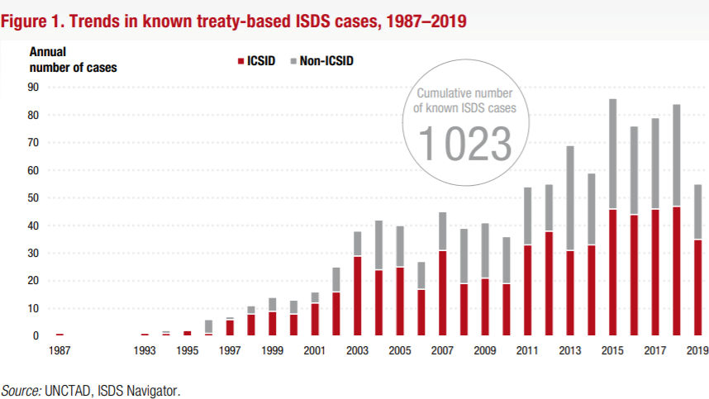
Investment Arbitration: A Recap

Slide 6
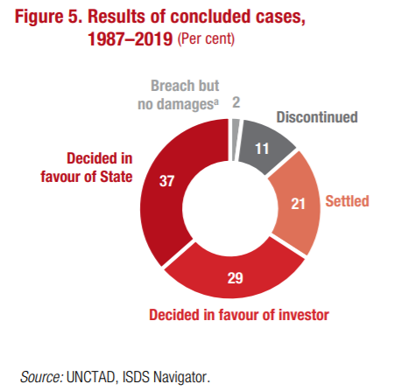
Investment Arbitration: A Recap

Slide 7
II. Investment Arbitration: The Critiques
“Their meetings are secret. Their members are generally unknown. The decisions they reach need not be fully disclosed. Yet the way a small number of international tribunals handles disputes between investors and foreign governments has led to national laws being revoked, justice systems questioned and environmental regulations challenged. And it is all in the name of protecting the rights of foreign investors under the North American Free Trade Agreement.” Nafta's Powerful Little Secret; Obscure Tribunals Settle Disputes, but Go Too Far, Critics Say, Anthony Depalma, The New York Times (11 March 2001).

Slide 8
II. Investment Arbitration: The Critiques
“[G]ive foreign firms a special right to apply to a secretive tribunal of highly paid corporate lawyers for compensation whenever a government passes a law to, say, discourage smoking, protect the environment or prevent a nuclear catastrophe. Yet that is precisely what thousands of trade and investment treaties over the past half century have done, through a process known as 'investor-state dispute settlement', or ISDS.” The arbitration game, The Economist (11 October 2014).

Slide 9
III. Multilateral Investment Court: A Solution?
Multilateral Investment Court proposed by the EU for all interested states to join
First instance and appellate tribunal with standing panel of full-time adjudicators selected by states
First instance tribunal: determine facts and apply law
Appellate tribunal: power to reverse legal findings or serious errors in the weighing of facts

Slide 10
III. Multilateral Investment Court: A Solution?
Adjudicators:
Full-time, long-term, and (apparently) non-renewable positions;
No outside activities; salaries comparable to other court systems paid by the MIC’s member states;
Expertise in public international law, adjudicating, and fact-finding;
Assisted by a permanent secretariat.
Proponents:
MIC would (i) remedy structural defects of ISDS; (ii) reduce costs and duration of dispute resolution; (iii) achieve transparency and predictability through binding precedents

Slide 11
IV. Multilateral Investment Court: History Repeated?
Transparency?
Transparency has been progressively implemented by tribunals through procedural orders:
Carrizosa v. Colombia, Procedural Order No. 2, 7 March 2019: “[T]he Parties agreed that the present proceedings should be transparent and that the Tribunal would issue a procedural order governing the transparency regime.”
Ipek v. Turkey, Procedural Order No. 11 on Use of Arbitration Materials, 21 February 2020: “Transparency [is] a means to promote good governance of States, the development of a well grounded and coherent body of case law in international investment law and therewith legal certainty and confidence in the system of investment arbitration.”

Slide 12
IV. Multilateral Investment Court: History Repeated?
Transparency?
UNCITRAL Rules on Transparency:
Article 3: “[T]he following documents shall be made available to the public: the [NOA], the response to the [NOA], the [SoC], the [SoD] and any further … written submissions … any written submissions by the non-disputing Party … and by third persons, transcripts of hearings …; and orders, decisions and awards of the arbitral tribunal.”
Article 6: “[H]earings for the presentation of evidence or for oral argument … shall be public.”

Slide 13
IV. Multilateral Investment Court: History Repeated?
Transparency?
In many cases, States oppose transparency of the arbitral proceeding
Amco Asia v. Indonesia
Rand Serbiav.
Metalclad v. Mexico, Decision on a Request by the Respondent for an Order Prohibiting the Claimant from Revealing Information, 27 October 1997: “Mexico requested the Tribunal to issue a formal order declaring that the proceedings are confidential …. The Respondent also complains of what it describes as a ‘publicity campaign by the Claimants.’”

Slide 14
IV. Multilateral Investment Court: History Repeated?
Transparency?
In any event, simple solution – amend BITs
2019 Dutch Model BIT, Article 20.13: “The ‘UNCITRAL Transparency Rules’ shall apply to disputes under this Section.”
Comprehensive Economic and Trade Agreement (CETA), Article 8.36.1: “The UNCITRAL Transparency Rules, as modified by this Chapter, shall apply in connection with [ISDS] proceedings under this Section.”
2014 Mauritius Convention: Entered into force in 2017. Seven ratifications; no EU Member States

Slide 15
IV. Multilateral Investment Court: History Repeated?
Third Party Participation?
Investment tribunals allow third parties to file amicus curiae briefs when public interests are at stake:
Philip Morris v. Uruguay
Infinito Gold Ltd. v. Costa Rica, Procedural Order No. 2, 1 June 2016: “APREFLOFAS’s general purpose as an NGO is the protection of the environment [and] can thus be deemed to have an interest in ensuring that this Tribunal has all the information necessary to its decision-making.”
Bear Creek v. Peru, Procedural Order No. 5, 21 July 2016: “[I]t appears to the Tribunal that … DHUMA’s local knowledge of the facts may add a new perspective that differs from that of the Parties.”

Slide 16
IV. Multilateral Investment Court: History Repeated?
Third Party Participation?
Non-disputing party submissions are increasingly common in investment arbitration
European Commission has intervened in numerous proceedings:
AES v. Hungary; Electrabel v. Hungary; Achmea v. Slovak Republic, Vattenfall v. Germany
Non-disputing party submissions are uncommon in many international courts

Slide 17
IV. Multilateral Investment Court: History Repeated?
Third Party Participation?
In any event, simple solution – amend BITs
2019 Dutch Model BIT, Article 20.13: “The Tribunal and the disputing parties shall give positive consideration to a request from a third party to submit as an amicus curiae oral or written submissions”

Slide 18
IV. Multilateral Investment Court: History Repeated?
Independence and Impartiality?
Existing ISDS mechanisms contain robust and highly-effective mechanisms for ensuring independence and impartiality of arbitrators
Parties’ Role in Selection
Substantive Requirements
Disclosure Obligations
Challenge and Removal Procedures

Slide 19
IV. Multilateral Investment Court: History Repeated?
Independence and Impartiality?
UNCITRAL Rules:
Article 11: “When a person is approached in connection with his or her possible appointment as an arbitrator, he or she shall disclose any circumstances likely to give rise to justifiable doubts as to his or her impartiality or independence.”
Article 12: “Any arbitrator may be challenged if circumstances exist that give rise to justifiable doubts as to the arbitrator’s impartiality or independence.”

Slide 20
IV. Multilateral Investment Court: History Repeated?
Independence and Impartiality?
IBA Guidelines on Conflicts of Interest in International Arbitration:
General Principle: “Every arbitrator should be impartial and independent of the parties at the time of accepting an appointment to serve and shall remain so until the final award has been rendered or the proceedings have otherwise finally terminated.”
Conflicts of Interest: “An arbitrator shall decline to accept an appointment or … refuse to continue to act as an arbitrator, if he or she has any doubt as to his or her ability to be impartial or independent. Doubts are justifiable if a reasonable third person, having knowledge of the relevant facts and circumstances, would reach the conclusion that there is a likelihood that the arbitrator may be influenced by factors other than the merits of the case as presented by the parties in reaching his or her decision.”

Slide 21
IV. Multilateral Investment Court: History Repeated?
Independence and Impartiality?
IBA Guidelines on Conflicts of Interest in International Arbitration:
Disclosure by the Arbitrator: “If facts or circumstances exist that may, in the eyes of the parties, give rise to doubts as to the arbitrator’s impartiality or independence, the arbitrator shall disclose such facts or circumstances …. Any doubt as to whether an arbitrator should disclose certain facts or circumstances should be resolved in favour of disclosure.”
Duties of the Parties and the Arbitrator: “A party shall inform … of any relationship, direct or indirect, between the arbitrator and the party … or between the arbitrator and any person or entity with a direct economic interest in … the award … The party shall do so on its own initiative at the earliest opportunity. A party shall inform … of the identity of its counsel appearing in the arbitration, as well as of any relationship … between its counsel and the arbitrator.”

Slide 22
IV. Multilateral Investment Court: History Repeated?
Independence and Impartiality?
ICSID Convention:
Article 14(1): “Persons designated to serve on the Panels shall be persons of high moral character and recognized competence in the fields of law, commerce, industry or finance, who may be relied upon to exercise independent judgment. Competence in the field of law shall be of particular importance in the case of persons on the Panel of Arbitrators.”
Article 57: “A party may propose to a Commission or Tribunal the disqualification of any of its members on account of any fact indicating a manifest lack of the qualities required by paragraph (1) of Article 14.”

Slide 23
IV. Multilateral Investment Court: History Repeated?
Independence and Impartiality?
MIC undermines adjudicators’ independence and impartiality: MIC appointed exclusively by states without participation by investors; states also decide compensation and, potentially, any reappointment of adjudicators
Disproportionate influence of one interested party on adjudicators, condemned in most settings:
Star Chamber: one side chooses all adjudicators, with respect to a narrow set of issues involving that side;
Court-packing: United States; Ecuador; Hungary; Poland

Slide 24
IV. Multilateral Investment Court: History Repeated?
Independence and Impartiality?
Posner & De Figueiredo (2004): “Strong evidence” that ICJ judges favor (1) state that appoints them; (2) states whose wealth level is close to judge own state’s; (3) states with similar political systems to judge own state’s. Judges voted for home state parties about 90% of the time, while about 48% for non-home states.
Voeten (2008): “Some evidence” that European Court of Human Rights judges’ “career insecurities make judges likely to favor their national government when it is a party to a dispute.” Study found that “evidence suggests that international judges are policy seekers [and] politically motivated actors.”

Slide 25
IV. Multilateral Investment Court: History Repeated?
Double Hatting?
Want adjudicators from the next generation, more diversity, people from developing countries, more women? Double hatting likely necessary
Simple solution if double-hatting is not desired:
2019 Dutch Model BIT, Article 20(5)
Comprehensive Economic and Trade Agreement (CETA), Article 8.30.1
ICSID and UNCITRAL Draft Code of Conduct for Adjudicators

Slide 26
IV. Multilateral Investment Court: History Repeated?
Forum Shopping?
Decisions have identified ‘forum shopping’ as an abuse of rights or an abuse of process, dismissing claims.
Phillip Morris v. Australia, Award on Jurisdiction and Admissibility, 17 December 2015: The Tribunal concludes that “the initiation of a treaty-based investor-State arbitration constitutes an abuse of rights (or an abuse of process, the rights abused being procedural in nature) when an investor has changed its corporate structure to gain the protection of an investment treaty at a point in time when a specific dispute was foreseeable.”
Levy and Gremcitel v. Peru, Award, 9 January 2015: “[T]he tribunal cannot but conclude that the corporate restructuring […] constitutes an abuse of process. Therefore, the Tribunal is precluded from exercising jurisdiction over this dispute.”

Slide 27
IV. Multilateral Investment Court: History Repeated?
Forum Shopping?
Simple solution – amend BITs:
In 2004, Chile and Korea terminated their 1996 BIT and replaced it with a new FTA which now includes a denial of benefits clause.
In 2009, Peru and Singapore terminated their 2003 BIT and replaced it with a new FTA which now includes a denial of benefits clause.

Slide 28
IV. Multilateral Investment Court: History Repeated?
Costly and Slow?
Average commercial arbitration is 12-18 months; average ICJ case is 4 years; average investment arbitration is approximately 3.86 years.
ISDS proceedings are comparatively slow principally because of states’ insistence on long and bifurcated proceedings:
States challenged the tribunal’s jurisdiction in approximately 41% of cases
States were completely successful in only 18.9% of those cases (or less than 8% of all cases)

Slide 29
IV. Multilateral Investment Court: History Repeated?
Costly and Slow?
Investors’ fees in bifurcated cases were $6.4 million, while in non-bifurcated cases $4.1 million.
Tribunal and administrative costs in bifurcated cases were around $1 million, while in non-bifurcated cases costs were 50% less.

Slide 30
IV. Multilateral Investment Court: History Repeated?
Costly and Slow?
States would bear costs of maintaining a MIC – adjudicators and staff salaries, permanent facilities:
International Tribunal for the Law of the Sea: has only heard 29 cases in 26 years, two of which were advisory opinions. Budget for the 2019-2020 period is EUR 20,521,200, although only two cases are pending before the tribunal.
International Criminal Court: estimated expenditure was around $900 million in first ten years (with one verdict)
Criminal Tribunal for the former Yugoslavia: annual budget increased 500-fold from its inception in 1993 until 2010-11, spent $695 million in its first ten years

Slide 31
IV. Multilateral Investment Court: History Repeated?
Costly and Slow?
An appellate mechanism will significantly increase costs and duration of proceedings.
Between 2011-2018, annulment under ICSID requested in 51% of awards even though success rate is only 3%. With broader review powers, appeals will increase.
De novo review may have perverse incentive of leading arbitrators to “overdo it” to ensure every single point, even tangential, is addressed and briefed.

Slide 32
IV. Multilateral Investment Court: History Repeated?
Right to Regulate Ignored?
Awards have repeatedly recognized states’ regulatory powers
Sun Reserve Luxco v. Italy, Award, 25 March 2020: “Not every shortcoming in a State’s action will justify a claim for breach of the FET standard … it must be shown that the host State’s conduct was manifestly or grossly unfair or unreasonable, was arbitrary or discriminatory, constituted a denial of justice in national proceedings in the host State, or that the host State engaged in a willful neglect of duty or a willful disregard of due process of law, or showed an extreme insufficiency of action falling far below international standards.”

Slide 33
IV. Multilateral Investment Court: History Repeated?
Right to Regulate Ignored?
Marfin v. Cyprus, Award, 26 July 2018: “The Tribunal considers that the economic harm consequent to the non-discriminatory application of generally applicable regulations adopted in order to protect the public welfare do not constitute a compensable taking, provided that the measure was taken in good faith, complied with due process and was proportionate to the aim sought to be achieved.”
Servier v. Poland, Award, 14 February 2012: “The Tribunal agrees with the Parties that a host state's regulatory and/or administrative actions must be taken (i) in good faith, (ii) for a public purpose, (iii) in a way proportional to that purpose, and (iv) in a non-discriminatory manner.”

Slide 34
IV. Multilateral Investment Court: History Repeated?
Right to Regulate Ignored?
Simple solution – Amend BITs
2012 U.S. Model Investment Treaty, Annex B Expropriation, ¶4(b): “Except in rare circumstances, non-discriminatory regulatory actions by a Party that are designed and applied to protect legitimate public welfare objectives, such as public health, safety, and the environment, do not constitute indirect expropriations.”
Comprehensive and Economic Trade Agreement (CETA), Article 8.9: “The Parties reaffirm their right to regulate within their territories to achieve legitimate policy objectives, such as the protection of public health, safety, the environment or public morals, social or consumer protection or the promotion and protection of cultural diversity.”

Slide 35
IV. Multilateral Investment Court: History Repeated?
Lack of Uniformity and Consistency?
More than 3,200 BITs with widely differing substantive standards
Different generations of BITs – 1970s versus 2020: widely differing standards based on widely different national objectives in different pairs of states – language, culture, stage of development, political climate
Deliberate policy choices between different sets of nations or geographic regions – no one size fits all; no uniformity (and no desire by states for uniformity)
MIC denies states autonomy to choose own solutions and dispute resolution mechanisms; instead, imposes single, Euro-centric set of standards

Slide 36
IV. Multilateral Investment Court: History Repeated?
Lack of Uniformity and Consistency?
Is there real lack of consistency?
Relatively few issues as to which different tribunals actually interpret and apply identical provisions in a materially different way (e.g., FET, MFN)
Inevitable differences in emphasis and reasoning in different decisions, even with identical provisions – occurs in virtually all national legal systems and is very unlikely to disappear entirely in a permanent court; is also not harmful
Consequences of “wrong” decisions for other tribunals are limited – future tribunals are not bound by “wrong” decisions

Slide 37
IV. Multilateral Investment Court: History Repeated?
Lack of Uniformity and Consistency?
Insofar as there are material differences in interpretation of broadly-phrased standards (like FET or MFN), the appropriate response to disagreement with particular interpretations is for States to:
Present their arguments to tribunal, explain transparently why one standard is preferable to another;
Transparently adopt interpretations of treaties;
Transparently amend treaties which are interpreted in ways that States do not support
The legitimate and politically-accountable manner to make changes to substantive standards. Not through packing tribunals with sympathetic judges; that is neither fair nor politically accountable

Slide 38
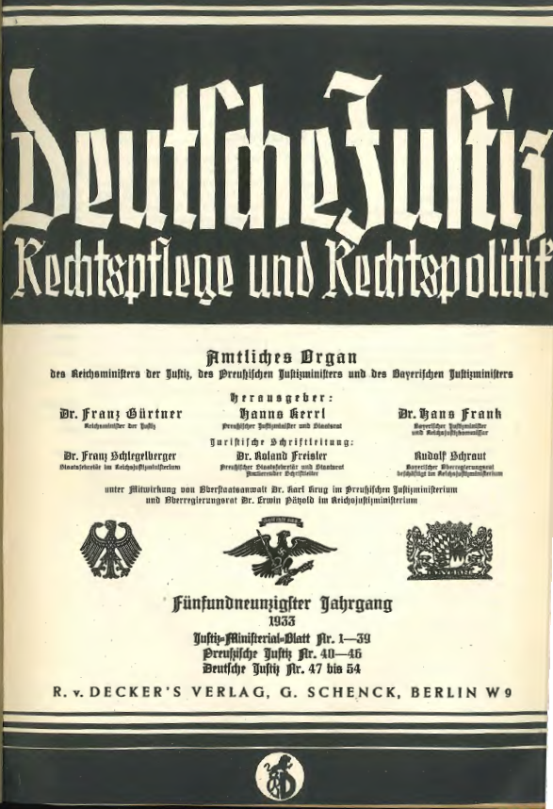
Multilateral Investment Court:
History Repeated?
1933 Reichs Directive: “[a]ll disputes arising from contracts between the Reich and private individuals are in principle to be brought to a decision before the state courts…”

Slide 39
IV. Multilateral Investment Court: History Repeated?
1933 Reichs Directive: “[the] advantages [of arbitration] are problematic in their nature and at any rate cannot compensate the disadvantage of far greater legal uncertainty of arbitration compared to litigation. Particularly because according to the prevailing opinion arbitrators are not bound by the applicable material law, because there is no principle of public nature of the proceedings, and because there is no safeguard like the stages of appeal, the organizational guarantees for the setup of an objective decision are far lower than in litigation, even if the arbitrators make every effort to ensure objectivity. Lastly, from a state policy point of view it has to be considered that an extension of arbitration ultimately presents a disturbance of the trust in the state courts and the state itself. [Therefore,] all disputes arising from contracts between the Reich and private individuals are in principle to be brought to a decision before state courts.”

Slide 40
A Multilateral Investment Court: History Repeated?
6th EFILA Annual Conference
January 14th, 2021

